Slide 1

Language Detection with Machine Learning
Romaric Sallustre + Sochi Aneke
31Jan2023

Slide 2

1
5
What is language detection?
The Test 🌈
2
How can we use ML for this?
6
Limitations
SUMMARY
3
The Task
7
Conclusion
4
The Code

Slide 3

Language Detection
1

Slide 4
What is Language Detection?
What is Language Detection?
The ability for a machine to take text input and determine in which language the text is written.
This can be applied to translation and tracking and identifying multilingual documents.
Language Detection with Machine Learning
Notes:
Have you ever been using your phone to translate something, maybe from French to your native language, or something your friend has said, and your smartphone says for example: “Hey…you don’t have DANISH downloaded on your phone…you have to download that first if you want to translate DANISH” and you’re like NOOOO iphone, i don’t even KNOW any Danish people! … Well this is an issue of Language detection. (explain the slide). We can’t begin to translate without first recognizing the initial language!

Slide 5
Machine Learning in Language Detection
2

Slide 6
Machine Learning in Language Detection
Supervised Learning
Give labeled data, train the model to make predictions, validate, and test.
Language Detection with Machine Learning

Slide 7
The Task
3

Slide 8
The Task
Identify a Dataset
Train a Model
Detect a Language
Criteria:
many languages
many entries/lang
sklearn
Naive Bayes
INPUT (X): Text
OUTPUT (y): Language
Language Detection with Machine Learning
Notes:
Naive Bayes is an algorithm best used for classification problems in supervised learning, so we will use it here.

Slide 9
The Code
4

Slide 10
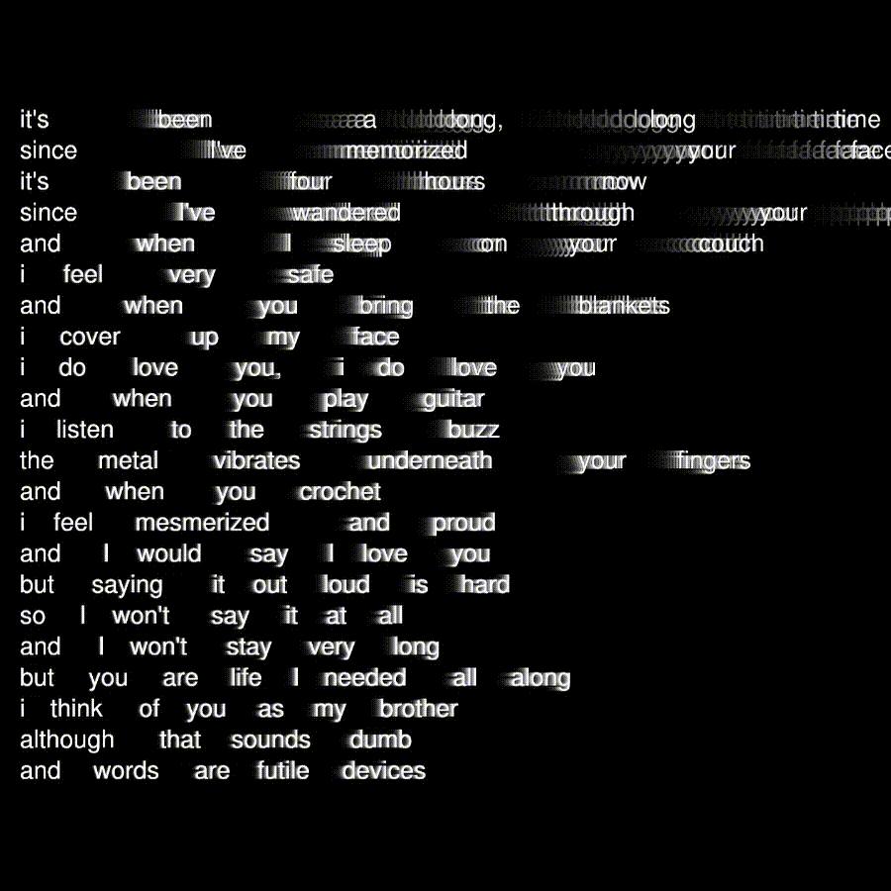
it
Notes:
https://colab.research.google.com/drive/1BGssKrIZxqimz-GD5u_jFCwDJ8dzIHiV?usp=sharing
Text processing:
Create categorical labels for languages with Label encoder
remove symbols from words
convert words into numerical values with CountVectorizer
Model:
We create a training set for the model with test train split
We created our model using Naive Bayes algorithm
Evaluate the model
Graphically represent with a confusion matrix / heat map
Try it out!

Slide 11
The Test
5

Slide 12

The Test
🌈
How well does our tool work?
Language Detection with Machine Learning

Slide 13
The Limitations
6

Slide 14

The Limitations
Limited Corpuses
Less data for nominally spoken languages
Ideal Dataset Size
Errors and crashes
Language Detection with Machine Learning
Notes:
Assembly language = I had trouble loading the dataset to begin with because of the way excel translates non-Latin characters into symbols. We had to search for solutions to circumvent this.

Slide 15

Conclusions
7

Slide 16
Conclusion
Lessons from NLP
Language Detection with Machine Learning
Notes:
In this class we have learned how to approach text language and the problems we may encounter (variability, ambiguity, and sparsity). It has been enlightening to see how pervasive NLP is in our modern technologies and the myriad of research issues that still need to be addressed. This task was fun to complete and puts context to the translation tools that I personally use daily.

Slide 17
Thanks!
!شكرًا لك
Merci!
Daalụ!
谢谢!
धन्यवाद!
Danke!
Спасибо!
!با تشکر
Grazie!
நன்றி!
¡Gracias!
ありがとう!
!תודה
Mulțumiri!
!شکریہ

